Slide 1
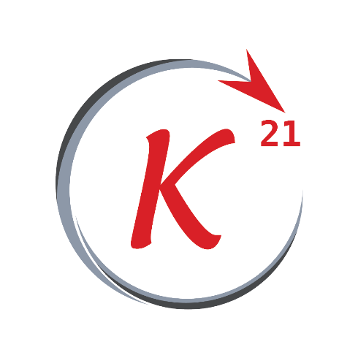
Python Basics

Slide 2
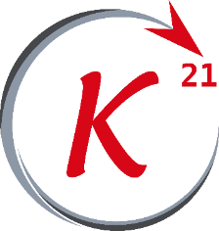
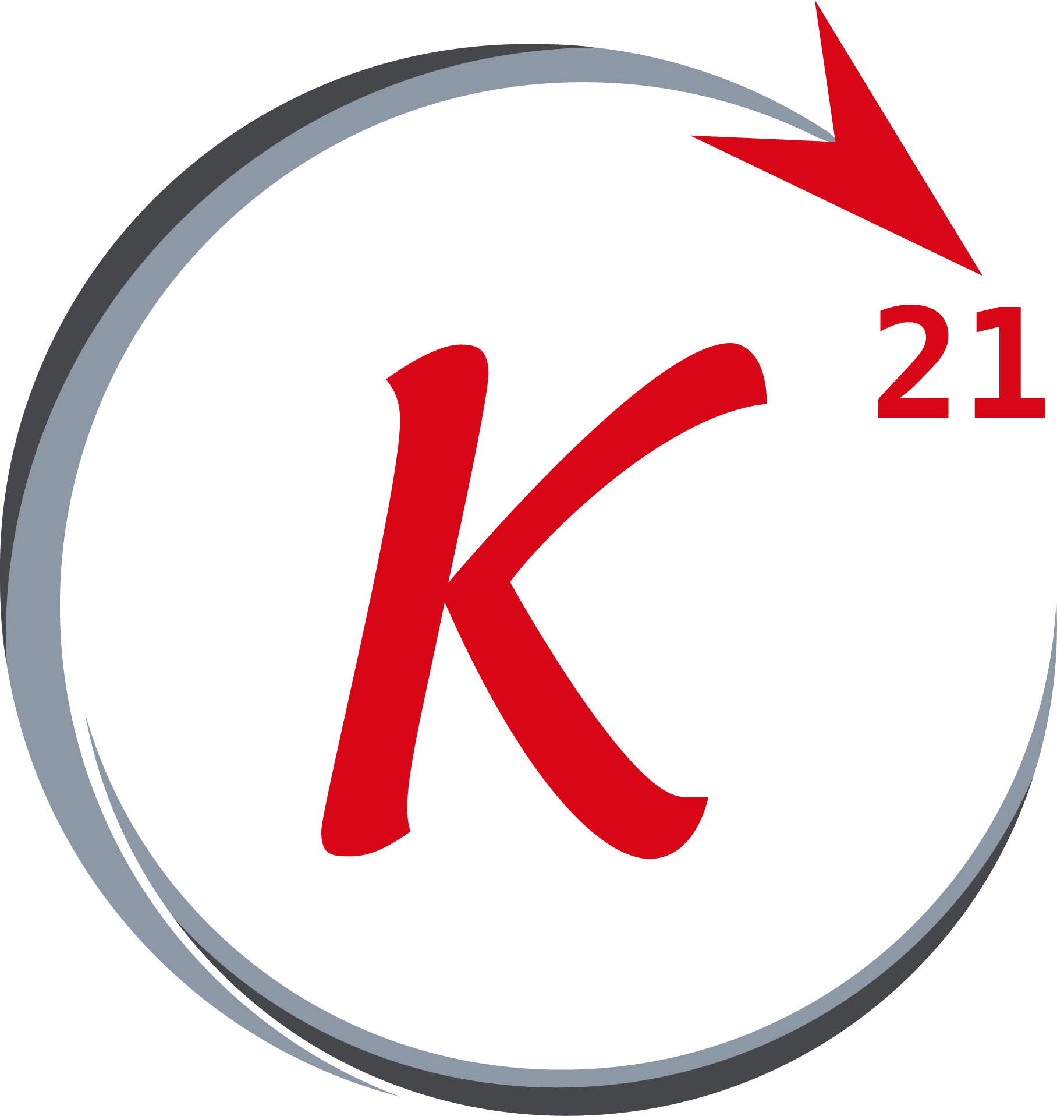


Python
Outline
About python
Program compilation
Installation
Syntax
Data types (1)
Arithmetic operations
Data types (2)
Logic and execution flow
Functions
Classes
Grow Through

Slide 3
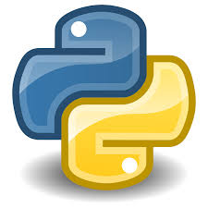
About Python
History
Python is a general-purpose programming language first introduced in 1991 by Guido van Rossum .
With python 2.0 being released in 2000 , and python 3.0 released in 2008 .
It is a high-level and dynamically typed language with garbage-
collection feature .
Grow Through

Slide 4
Program compilation
Python bytecode and P.V.M.
Python code is first compiled to python bytecode, a lower level language that python’s virtual machine uses to execute each line of code typed in the source code, the PVM is installed by the python installer and runs on top of the operating system (Windows, MacOS, etc.. ) .
The bytecode when cached is stored in .pyc & .pyo files and if no change made in the source code file, python skips the compilation to bytecode process and uses the old cached bytecode file .
Grow Through

Slide 5
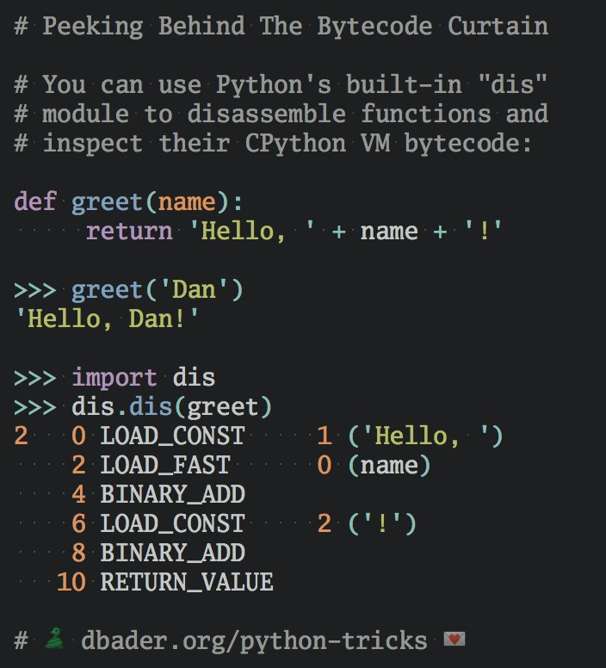
Program compilation
Python bytecode and P.V.M.
By dbader
Grow Through

Slide 6
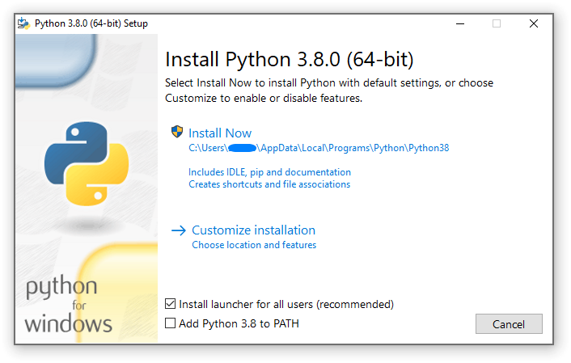
Installation
Python & IDLE
Python can be downloaded from the official website www.python.org .It comes with IDLE which is a simple python text editor used to type and edit python files .
We will be using python 3.8.x in this workshop .
Grow Through

Slide 7
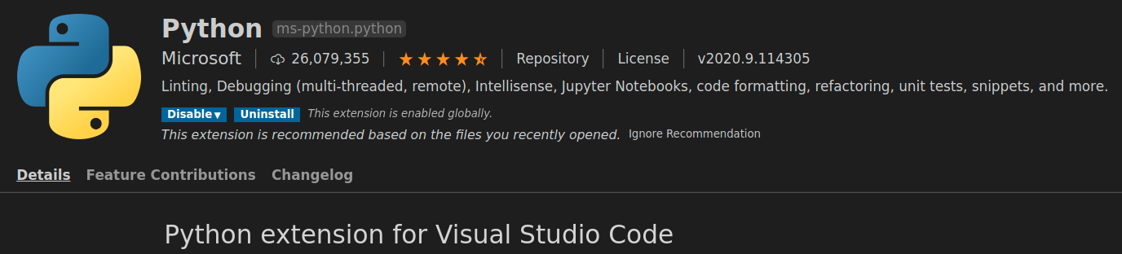

Installation
IDE : VS-Code
A very popular and open-source IDE to use is visual studio code, it has a python extension made and maintained by Microsoft makes writing python code an easy task .
Grow Through

Slide 8
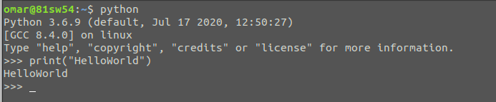
Installation
Running a python program
Use python interpreter to run simple python code, python interpreter can be opened using python.exe program or calling “python” on any of the command line tools if python is already added to the PATH .
Grow Through

Slide 9
Syntax
Variables
variables are the names of an object in python .When we try to call an object we use the name referring to it .
>>> x = 4
>>> type(x)
<class 'int'>
>>> y = 4.0
>>>type(y)
<class 'float'>
>>>print(x, y)
4 4.0
Grow Through

Slide 10
Syntax
#
Comments
There is no mutli-line comment in python . :(
Grow Through

Slide 11
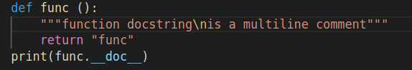
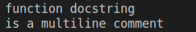
Syntax
Docstrings
Docstring is a commented string that is used to document objects in python .
It’s used by inserting the comment inside a triple double or single quotes .
Docstrings and comments aren’t so much alike, docstring doesn’t get ignored by the compiler like regular comments but is stored inside the program can can be viewed in program's life time .
Outputs
Grow Through

Slide 12
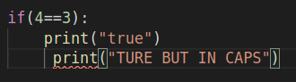
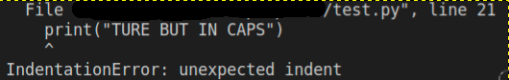
Syntax
Indentation
Indentation is a way in python to determine the scope of objects, like the curly braces in other programming languages .
We always indent a block of code one space or more to represent that it’s inside another block and all the lines of the inner block must be indented the same amount of spaces, otherwise this causes an indentation error .
Grow Through

Slide 13
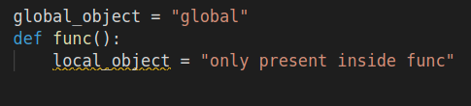
Syntax
Scopes
A scope of an object are the places on the code that the object can be called in and be recognized by the interpreter .
An object generally has the scope of its indentation level, for zero indentation level the object would have a global scope, if the object is defined inside a function then it will be available inside its function only ( will have its function’s inner scope ) .
Grow Through

Slide 14
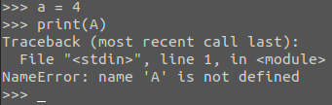
Syntax
Case sensitivity
Python is a case-sensitive language .
Grow Through

Slide 15
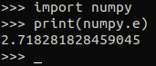
Syntax
Import Statement
“import” keyword is used to include a python package, module, class, function, etc ... into the current python project so these objects can be called inside the source code .
Grow Through

Slide 16
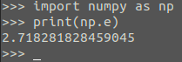
Syntax
Import Statement
“import” keyword can be used in many different forms, one of them is “import _ as _” .
Grow Through

Slide 17
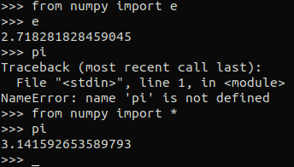
Syntax
Import Statement
but pi wasn’t :(
e was detected
* means all, so it basically tells python to import the whole module and attach it to the current namespace .
Grow Through

Slide 18
Syntax
Search path for import
An import statement will search for the mentioned module in the following order :
current folder
echo $PYTHONPATH
sys.path
Grow Through

Slide 19
Data types -1
integer
int is a data type that stores integers, its initial size is 24 bytes and can scale up to as much memory as the machine can give . Also we don’t need to specify a data type for the variable we store our object in and we can change the variable’s data type later on the code due to python being dynamically-typed language .
>>>x = 4
>>>type(x)
<class 'int'>
>>>import sys
>>>sys.getsizeof(x)
28
Grow Through

Slide 20
Data types -1
float
float is a date type that stores floating point numbers, i.e. any real number to a limited precision .
>>>x = 4.0
>>>type(x)
<class 'float'>
>>>import sys
>>>sys.getsizeof(x)
24
Grow Through

Slide 21
Data types -1
string
A data type used to store a sequence of characters . A string can be initialized using single or double quotes .
>>>x = 'my string'
>>>type(x)
<class 'str'>
>>>import sys
>>>sys.getsizeof(x)
57
Grow Through

Slide 22
Data types -1
casting
Casting is the process of converting one data type to another .
>>>x = int(54.34) >>>x = float(45)
>>>print(x) >>>print(x)
54 45.0
>>>type(x) >>>type(x)
<class 'int'> <class 'float'>
Grow Through

Slide 23
Data types -1
casting
Casting can also be done with strings .
>>>x = int(“54”) >>>x = float(“45.34”)
>>>print(x) >>>print(x)
54 45.34
>>>type(x) >>>type(x)
<class 'int'> <class 'float'>
Grow Through

Slide 24
Data types -1
boolean
boolean is a value that represents one of two states, True or False, being equal to 1 or 0 respectively . Note also that any number other than 0 can represent the True state .
>>>x = True >>>x = False
>>>print(x) >>>print(x)
True False
>>>type(x) >>>type(x)
<class 'bool'> <class 'bool'>
>>>bool(1) >>>bool(0.0)
True False
Grow Through

Slide 25
Data types -1
None
None is a reserved keyword in python used to define a no value . None is not the same as 0, False, or an empty string. None is a data type of its own (Nonetype) and only None can be None .
>>>x = None >>>None == None
>>>type(x) True
<class 'Nonetype'> >>>None != None
>>>bool(x) False
False
>>>None == False
False
Grow Through

Slide 26
Arithmetic operations
+
Addition
Grow Through

Slide 27
-
Arithmetic operations
Subtraction
Grow Through

Slide 28
Arithmetic operations
*
Multiplication
strings can also be multiplied by an integer n resulting a repeated string n times
Grow Through

Slide 29
Arithmetic operations
/
Division
For integer division we use double slash instead of a single one
Grow Through

Slide 30
Arithmetic operations
%
Modulo
Modulus also works with floating point numbers in python
Grow Through

Slide 31
Arithmetic operations
Modulo
Q: Given the periodic sin(input) that only works within the period range [-pi, pi], modify the input so the given sin function can calculate beyond this range .
input = (input + pi) % 2*pi - pi
Grow Through

Slide 32
Arithmetic operations
Power
**
Grow Through

Slide 33
Data types -2
Collections
List is a collection which is ordered and changeable. Allows duplicate members.
Tuple is a collection which is ordered and unchangeable. Allows duplicate members.
Set is a collection which is unordered and unindexed. No duplicate members.
Dictionary is a collection which is unordered, changeable and indexed. No duplicate members.
Grow Through

Slide 34
Data types -2
list
An ordered collection .
>>>x = [1,2,3,'and a string']
>>>print(x)
[1, 2, 3, 'and a string']
>>>x[1]
2
>>>x[1] = 2.2
>>>print(x)
[1, 2.2, 3, 'and a string']
Grow Through

Slide 35
Data types -2
tuple
An ordered & unchangeable collection .
>>>x = (1,2,3,'and a string')
>>>print(x)
(1, 2, 3, 'and a string')
>>>x[1]
2
>>>x[1] = 2.2
TypeError: 'tuple' object does not support item assignment
Grow Through

Slide 36
Data types -2
set
An unordered & unindexed collection .
>>>x = {1,2,3,'and a string'}
>>>print(x)
{1, 2, 3, 'and a string'}
>>>x[1]
TypeError: 'set' object does not support indexing
Grow Through

Slide 37
Data types -2
dict
An unordered & indexed collection .
>>>x = {1:4,2:'two',3:3,'and a string':'mapping to another string'}
>>>print(x)
{1:4, 2:'two', 3:3, 'and a string':'mapping to another string'}
>>>x[1]
4
>>>x['and a string']
'mapping to another string'
Grow Through

Slide 38
Logic and execution flow
Equality
The equality comparison returns True or False based on the two sides of the comparison .
>>>x = 1
>>>x == 1
True
>>>x == 1.0
True
>>>x == '1'
False
Grow Through

Slide 39
Logic and execution flow
Less or greater than
>>>x = 1
>>>x > 1
False
>>>x >= 1.0
True
>>>x < '1'
TypeError: '<' not supported between instances of 'int' and 'str'
Grow Through

Slide 40
Logic and execution flow
Inequality
>>>x = 1
>>>x != 1
False
>>>x != 2
True
>>>x != '1'
True
Grow Through

Slide 41
Logic and execution flow
is, in & not
is keyword is used to to check whether two variables referring to the same object or not, while in is used to check whether an object is present inside another object or not .
is and in keywords can be suffixed and prefixed respectively with not to alter their behavior .
not keyword is equivalent to the exclamation mark (!) in other languages .
>>>not True
False
Grow Through

Slide 42
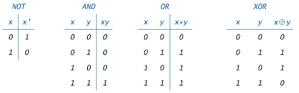
Logic and execution flow
or & and
or operation returns True if at least one of its operands is True .
and operation returns True if and only if all of its operands are True .
>>>True or False
True
>>>True and False
False
>>>True and True
True
and & or truth table
Grow Through

Slide 43
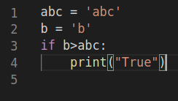
Logic and execution flow
if
An if statement executes if and only if its conditional expression returns True .
Outputs True because strings are compared by
their lexicographical order .
Grow Through

Slide 44
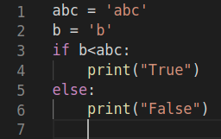
Logic and execution flow
else
Else keyword may follow an if statement to determine what happens in case the if statement wasn’t executed .
Grow Through

Slide 45
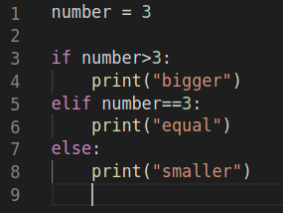
Logic and execution flow
elif
Because the indentation matters in python, each single else-if statement would need an extra indentation tab, would result in a bad looking code .
An elif keyword doesn’t need extra indentation so would make a much cleaner code .
Outputs “equal”
Grow Through

Slide 46
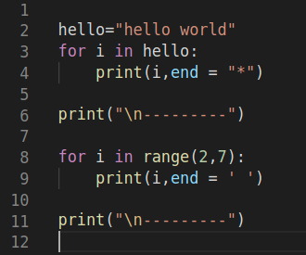
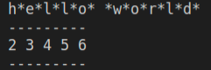
Logic and execution flow
for
Outputs
Grow Through

Slide 47
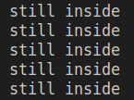
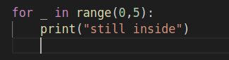
Logic and execution flow
_
When we have no interest in the value of the iterator in each iteration, we can use _ which just ignores ( doesn’t store ) the iteration’s value .
Outputs
Grow Through

Slide 48
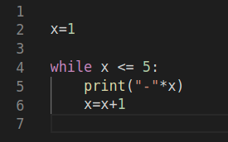
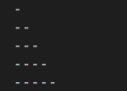
Logic and execution flow
while
A while loop keeps executing its scope until its condition is False, the loop stops at this point .
Grow Through

Slide 49
Logic and execution flow
.=
A simpler way to write x=x+1 is x+=1, the same applies for all other arithmetic operations .
E.g.
x=x**2 is the same as x**=2
also
x=x//7 is the same as x//=7
And so on …
Grow Through

Slide 50
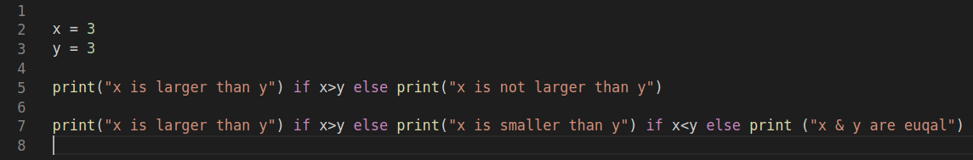
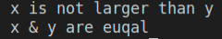
Logic and execution flow
Ternary operator
Python doesn’t have the conventional ternary operator “condition ? true_exe:false_exe “
but has a more descriptive statement : “true_exe if condition else false_exe” .
Grow Through

Slide 51
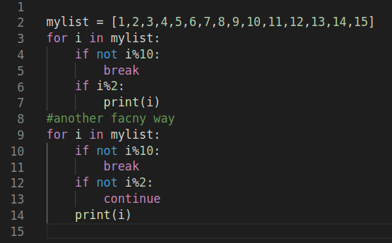
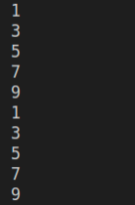
Logic and execution flow
break & continue
break keyword exits the enclosing running loop, and the continue statement causes the interpreter to stop executing the current iteration and start from the beginning of the loop .
Grow Through

Slide 52
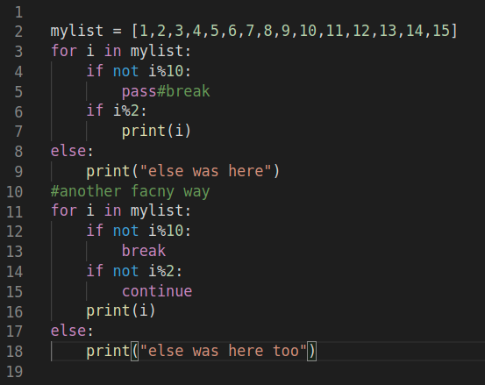
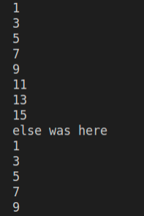
Logic and execution flow
else after loops
An else statement after a loop would execute if the condition of the loop ever evaluates to False .
Grow Through

Slide 53
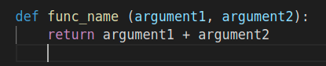
Functions
Definition
A function is defined with def keyword followed by the name of the function followed by a couple of parentheses that holds the function’s arguments .
Grow Through

Slide 54
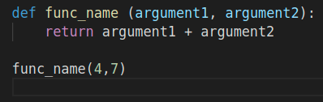
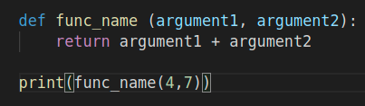
Functions
Invocation
We write the name of the function followed by a couple of parentheses holding the passed arguments or empty parentheses in case the function can take no arguments .
But this code won’t output the return value
because we didn’t print It, when we run python
file any return value for each line of code is not
outputted like in the interpreter .
Outputs 11
Grow Through

Slide 55
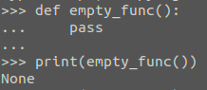
Functions
Empty function
We can’t write a function in python and just leave it empty . We use pass keyword in this case :
Because such a function doesn’t return anything in this case, when we invoke it inside print() we get None, which means no value.
Grow Through

Slide 56
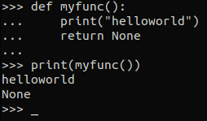
Functions
return
return keyword is used to return a value to the caller of the function .We can use it multiple times in one function based on some sort of conditions and we can never use it at all which in this case the function would finish executing and return None, we can also explicitly return None .
None doesn’t output in the
interpreter unless it’s printed .
Grow Through

Slide 57
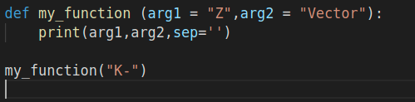
Functions
Default arguments
An argument can have a default value to be used in case no value was passed for its parameter to the function .
The code above outputs “K-Vector”, the first parameter has a passed argument but the second parameter doesn’t have an argument so it uses its default argument .
Grow Through

Slide 58
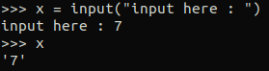
Functions
print() & input()
print() is used to output the value it gets to the console, it behaves differently with different data types.
input() in the other hand is used to retrieve an input from the console and it only gets the input as a string, so sometimes we need to convert it to a different data type before working with it, input also takes an argument and outputs it before asking for input .
Grow Through

Slide 59
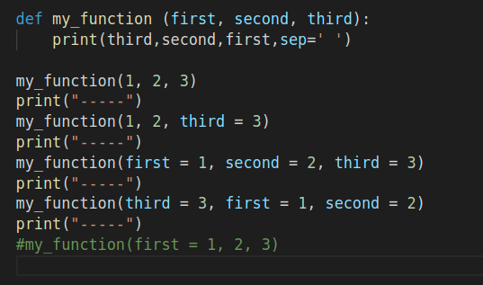
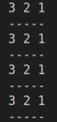
Functions
Positional and named arguments
Grow Through

Slide 60
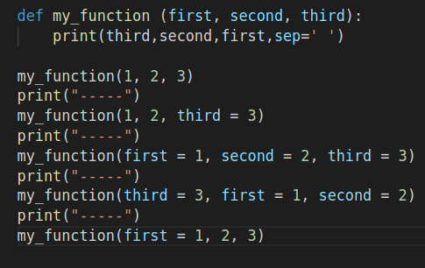
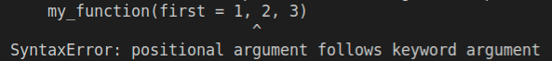
Functions
Positional and named arguments
The code won’t compile with syntax errors, so we can’t even
see the output of the first few lines although the error is in
the last line .
Grow Through

Slide 61
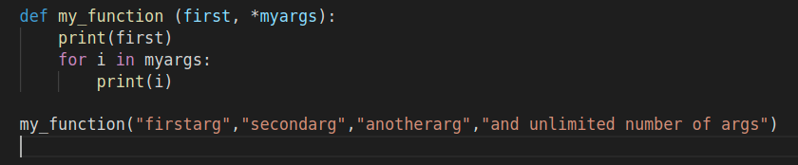
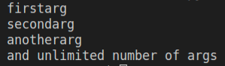
Functions
*args
*args is used to collect an unlimited number or positional arguments and stores them inside a tuple called args .
Grow Through

Slide 62
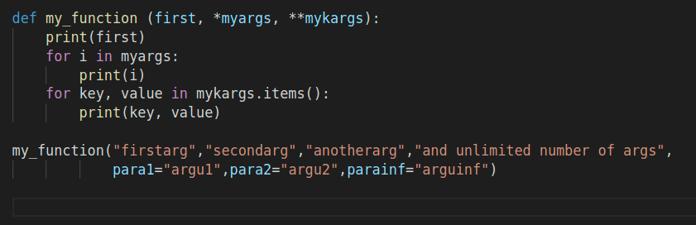
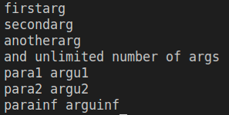
Functions
**kargs
*kargs is used to collect an unlimited number or named arguments and stores them inside a dictionary called kargs with the key being the parameter and the value being the argument .
Grow Through

Slide 63
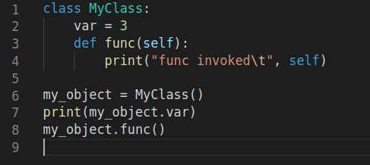
Classes
definition
Classes are defined with class keyword .
Grow Through

Slide 64
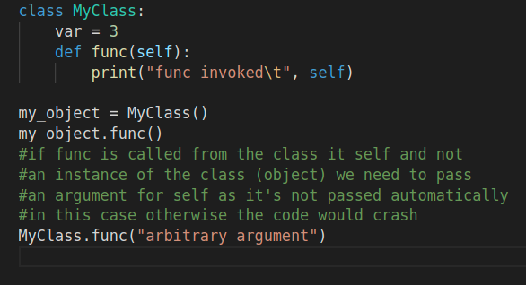
Classes
self
self is a keyword referring to the object instantiated from that class. Any function in the class would be passed self as the first argument if it was called by an object of the class.
Grow Through

Slide 65

Classes
__init__()
__init__(self, *args, *kargs) is the function getting called once an instance of the class is made (constructed) .
Grow Through

Slide 66

Classes
isinstance()
isinstance(object, class) function is used to check whether an object is of a particular class or not .
Grow Through

Slide 67
Thank You

